Slide 1
Final Project
Study on cardiovascular diseases data
Justin Zhaoying Lu, Tengxiao Song, Qingxuan Wu
CIS 5450 Fall 2023

Slide 2
Background
Cardiovascular Diseases(CVD)
Encompass disorders affecting the heart and blood vessels
Leading global cause of morbidity and mortality, representing 32% of global deaths in 2019^{[1]}.
Risk factors: genetics, age, gender, lifestyle choices (diet, exercise, smoking), underlying health conditions
[1]: World Health Organization. https://www.who.int/news-room/fact-sheets/detail/cardiovascular-diseases-(cvds)
Notes:
Presenter:
Estimated Time: 20s

Slide 3
Problem Statement
Dataset: Cardiovascular Diseases Risk Prediction Dataset
Objectives:
Build machine learning models to predict whether an individual has CVD or not
Identify & rank the important factors contributing to the risk of having CVDs.
Notes:
Presenter:
Estimated Time: 15s

Slide 4
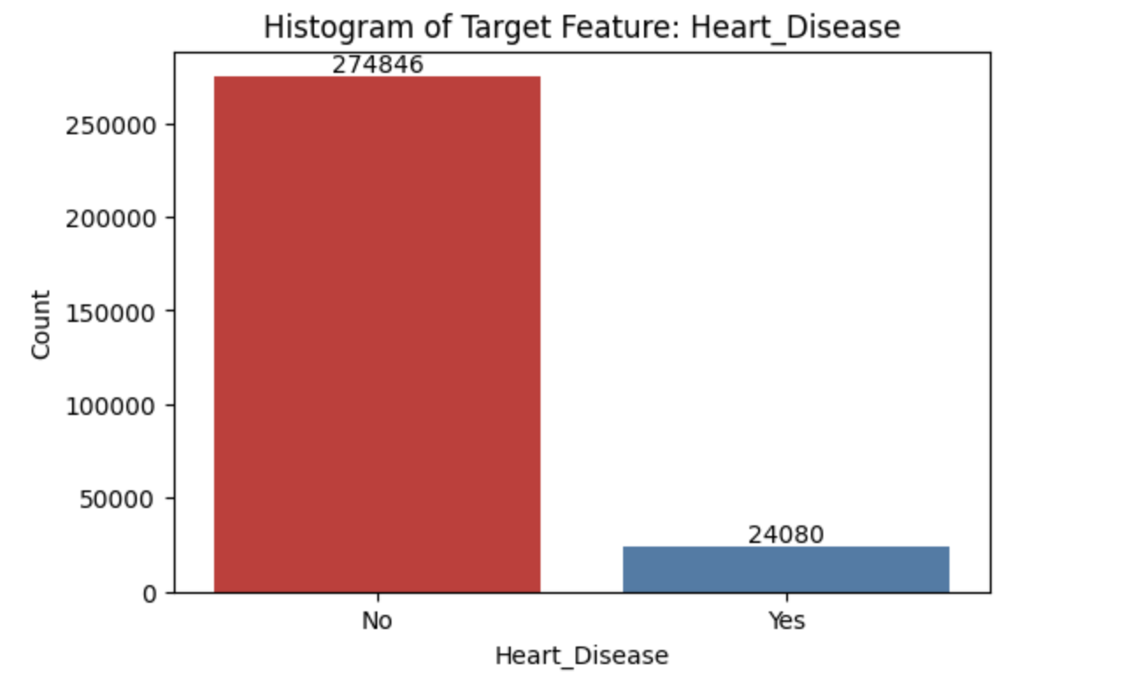
EDA
≈8%
Imbalance
AUROC
Notes:
Presenter:
Estimated Time: 1min

Slide 5
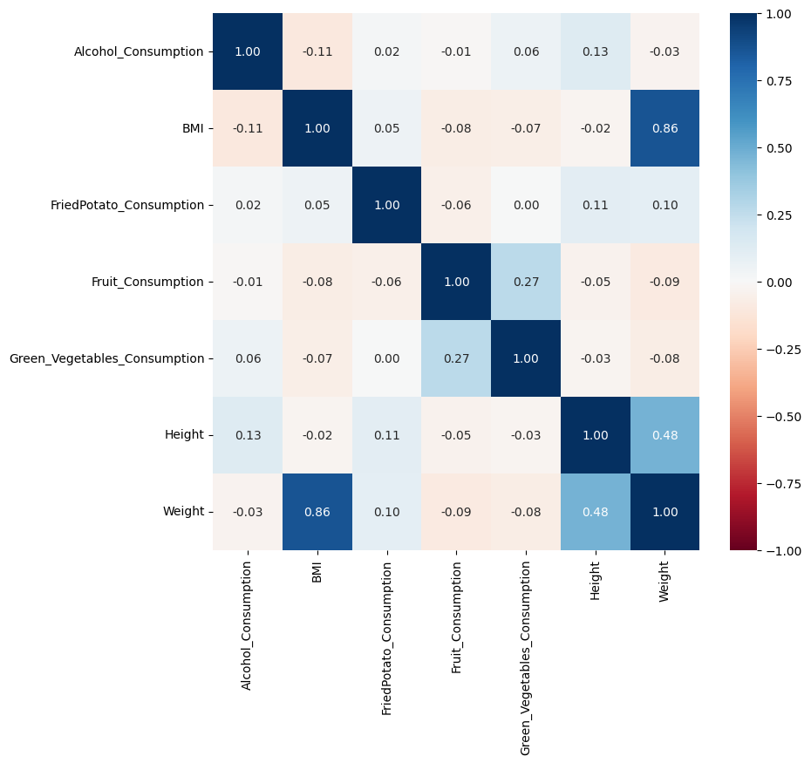
Correlation Matrix
multicollinearity

Slide 6
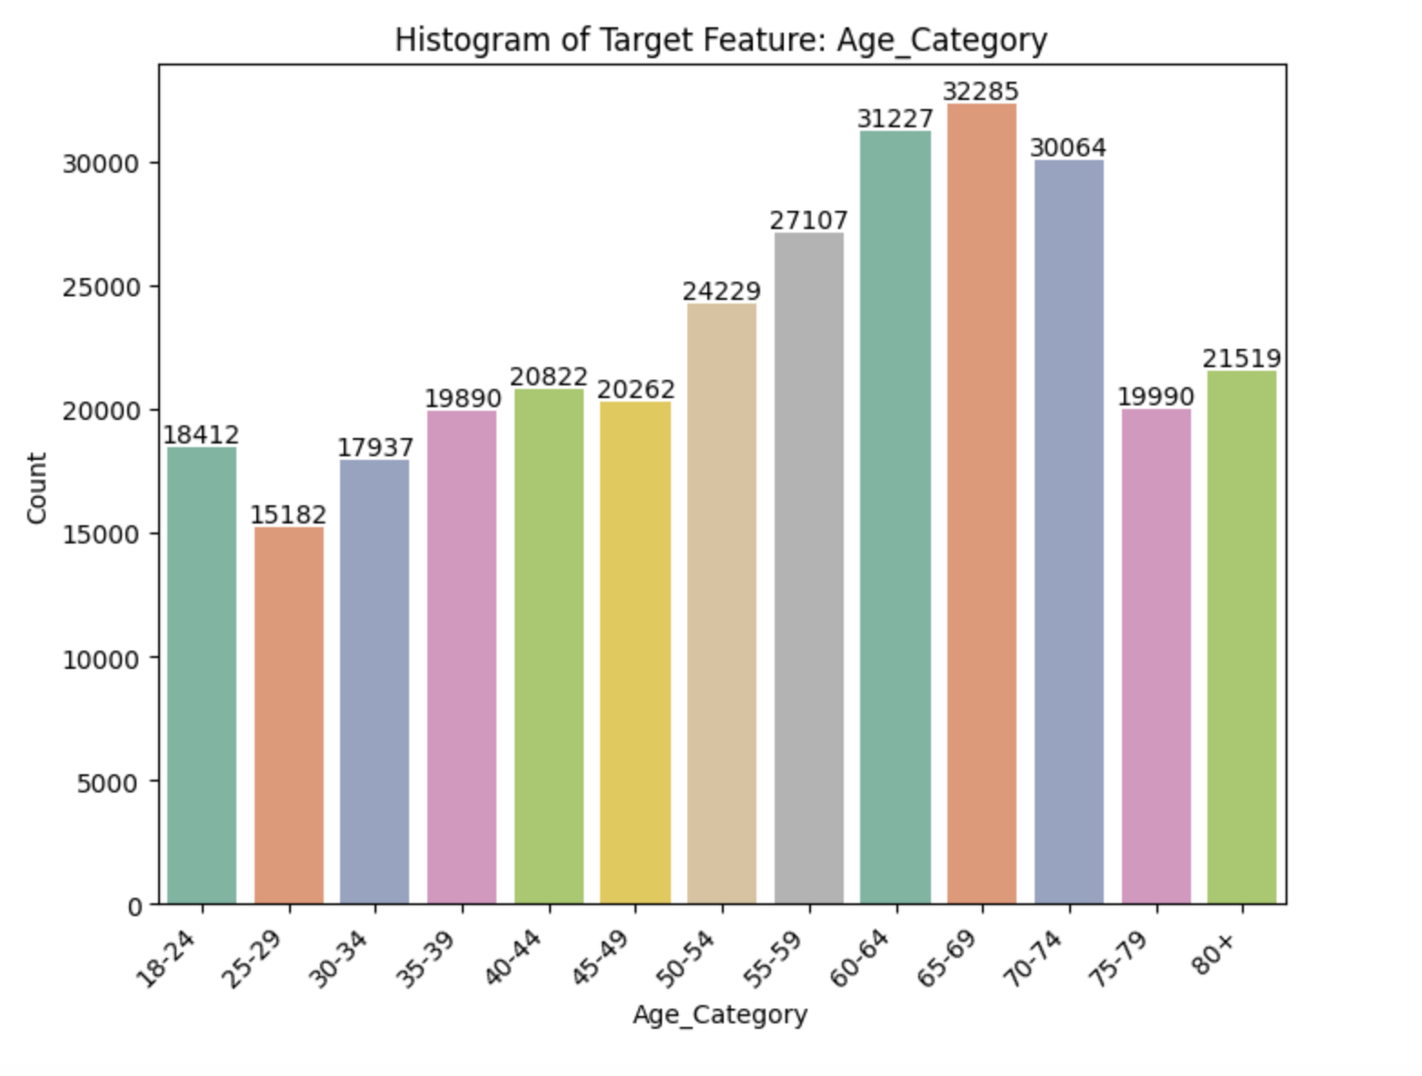
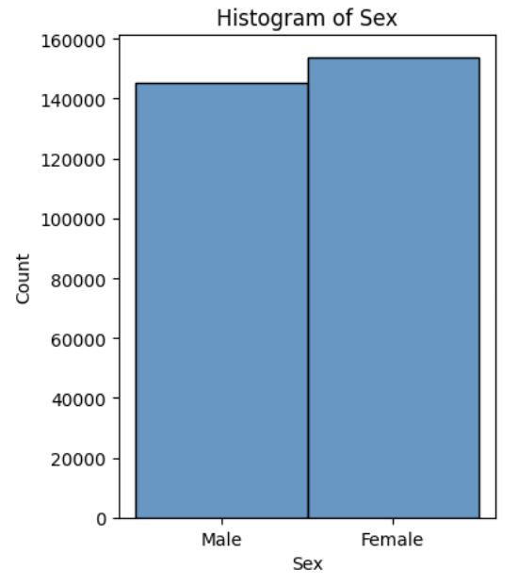
Distribution Disparity
Sex: more females
Age: more elders

Slide 7
Modeling: Model Selection
Logistic Regression (flexible and interpretable)
XGBoost (best performance)
LR with PCA
Decision Tree
Random Forest
Notes:
Presenter: Peter
Estimated Time: 20s
To study our dataset, we employed five different models, including both tree-based and probabilistic models, from the simplest logistic regression, to the complex random forest and XGBoost.
After evaluating comprehensively based on the prediction performances, interpretability and predictive flexibility of the models, we selected logistic regression for its relative flexibility, interpretability and XGBoost for its best predictive performance.

Slide 8
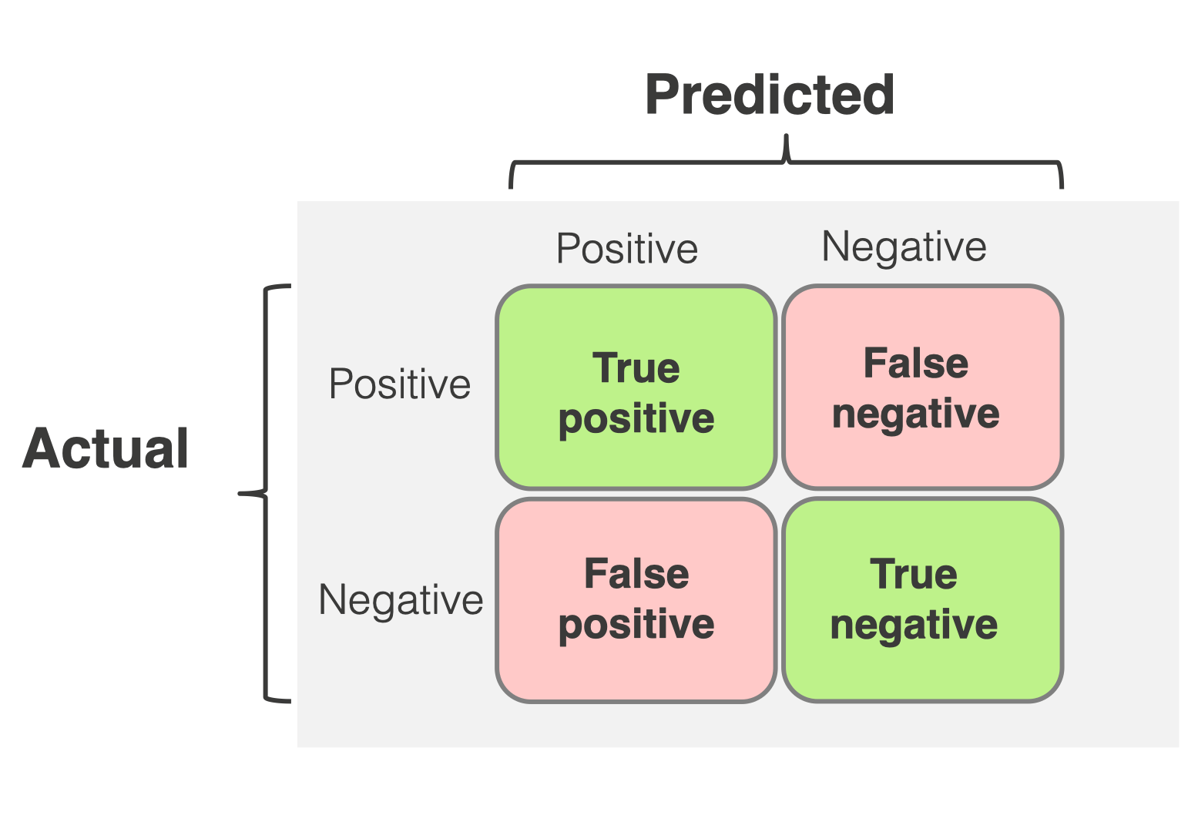
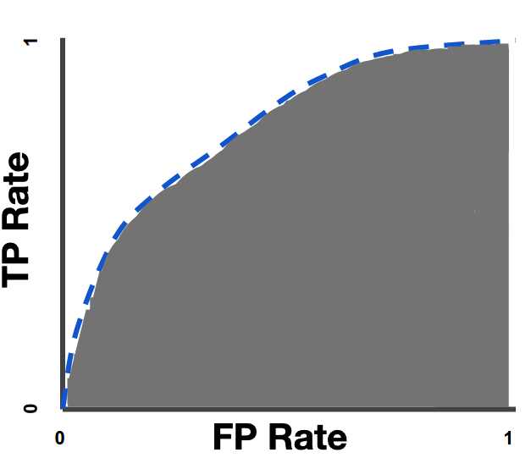
Modeling: Metrics
Why do we use AUROC instead of “accuracy”?
A “Dummy” model always predicting negative would have 92% accuracy. Absurd!
(↑) True Positive Rate (TPR): % of actual patients detected
(↓) False Positive Rate (FPR): % of healthy people mispredicted
AUROC: A measure of tradeoff between TPR vs. FPR
Notes:
Presenter: Peter
Time: 40s
TPR: The proportion of actual CVD patients predicted to have the disease
FPR: The proportion of healthy people predicted to have the disease
AUROC: Area Under the Receiver Operating Characteristic (ROC) curve.
A zero-to-one number that measures how good the model handles the tradeoff between TPR and FPR.
It’s a better metric than accuracy as it is more robust against sample imbalance present in our dataset.

Slide 9
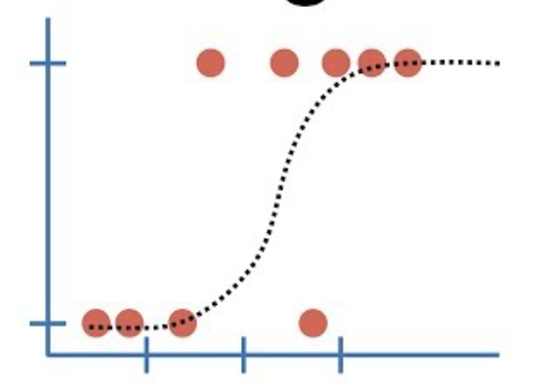
Model 1: Logistic Regression
Simple & effective linear model that predicts the probability of a patient having cardiovascular disease.
Offers ease of interpretation and flexible thresholds
Achieves 81% AUROC on testing dataset.
Notes:
Presenter: Peter
Estimated Time: 40s
Logistic regression is a simple and effective linear model that predicts the probability of a person having cardiovascular disease. Comparing to the complex machine learning models, it offers the benefit of a direct mathematical interpretation of model coefficients.
Specifically, the model coefficient corresponding to a variable is the increase in a mathematical quantity called log-odds when that variable increases by 1 unit.
The model outputs probability instead of hard classification, allows for the classification threshold to be changed depending on our scenario. For our case, a more permissive threshold might be set to catch as many true positives as possible, even at the cost of more false positives.

Slide 10
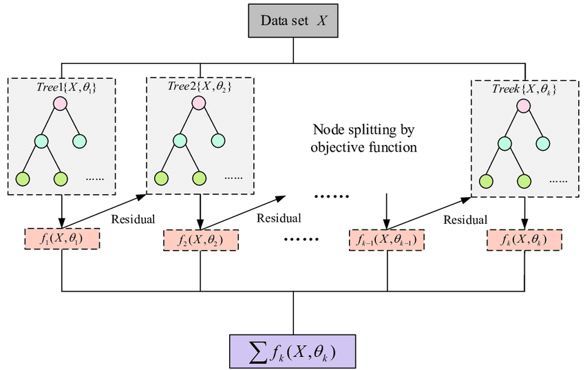
Model 2: XGBoost
Decision tree-based boosting model
High classification accuracy
82% AUROC
80% TPR at ~30% FPR
Notes:
Presenter: Peter
Estimated Time: 40s
XGBoost is a boosting model in that it combines multiple smaller models sequentially, each one correcting the previous models’ error.
The smaller models are called decision trees, which are basically flowcharts that makes decisions based on features.
The main benefit offered by the model is that it has higher classification accuracy compared to simpler models such as logistic regression.
In our setting, it achieves 82% area under the ROC curve.
To illustrate that, our model could detect a cardiovascular patient 80% of the time, for the price of a little more than 30% chance of a healthy person classified as ill.
This performance is good enough to serve an early-warning purpose to remind people of their risk of cardiovascular disease.

Slide 11
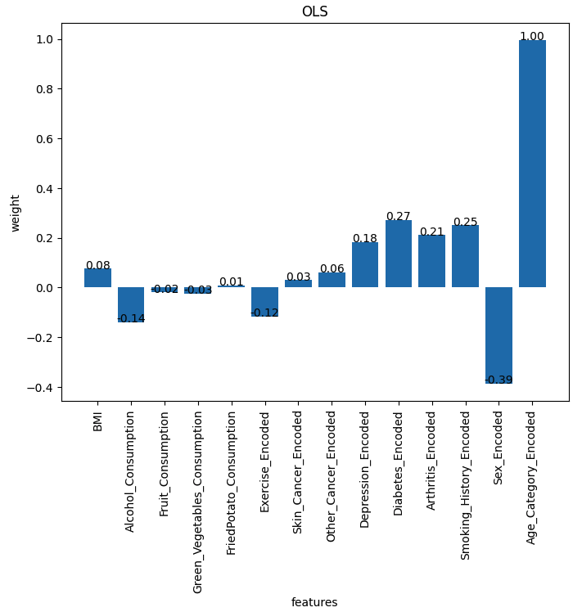
Implications: what does the data tell us?
Related factors
Demographic
age (+1.00), sex^{[1]} (-0.39)
BMI (+0.08)
Lifestyle
smoking (+0.25), alcohol (-0.14), exercise (-0.12)
vegetable (-0.03), fruit (-0.02), fried potato (+0.01)
Other medical conditions
diabetes (+0.27), arthritis (+0.21), depression (+0.18)
other cancer (+0.06), skin cancer (+0.03)
[1]. Data encoding uses 1 for female, 0 for male
Notes:
Presenter:
Estimated Time: 3min

Slide 12
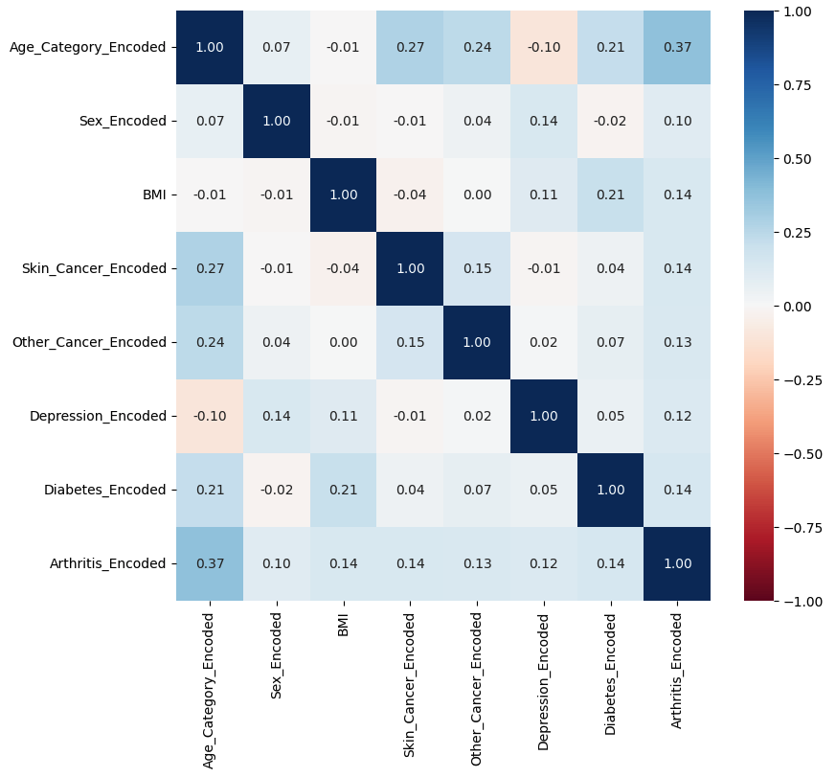
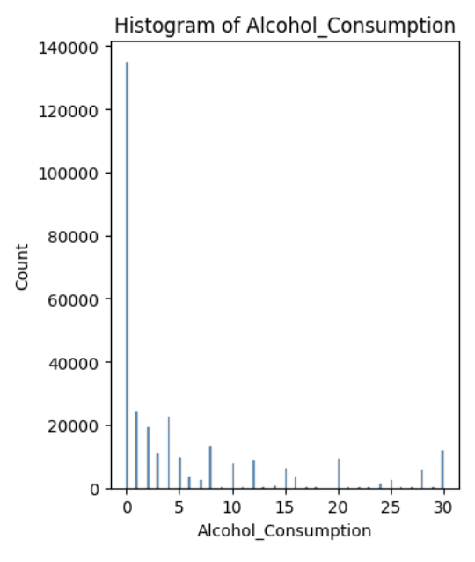
Implications: what does the data tell us?
Observations! Not determining factors.
correlation ≠ causation
hypotheses?
Notes:
Presenter:
Estimated Time: 3min

Slide 13
Implications: what does the data tell us?
Observations! Not determining factors.
correlation ≠ causation
hypotheses?
Real-world applications
Risk indicator: recommendation for further screening
Further research on the mechanism behind the correlations (depression, alcohol)
Notes:
Presenter:
Estimated Time: 3min

Slide 14
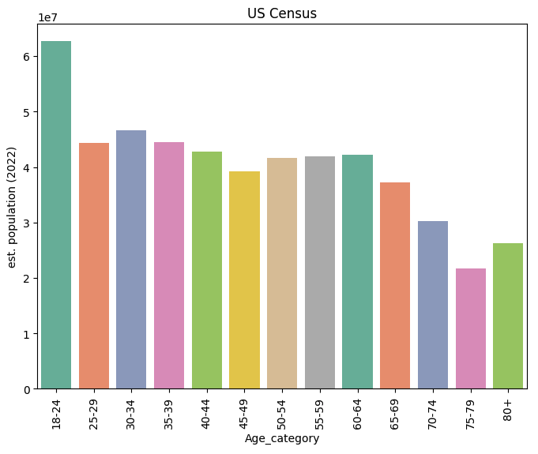
Limitations, and future work
Limitations
only correlation we observe - no recommendation given
data granularity: e.g. smoking is a 0-1 variable
data authenticity: self-reported data
data imbalance
Our data
General population
Notes:
Presenter:
Estimated Time: 2min

Slide 15
Limitations, and future work
Limitations
only correlation we observe - no recommendation given
data granularity: e.g. smoking is a 0-1 variable
data authenticity: self-reported data
data imbalance
Future steps
More data, better granularity, more attributes (clinical data, family medical history)
Further studies on correlated factors
Notes:
Presenter:
Estimated Time: 2min

